Slide 1
The Internet
Prof. Yousef B. Mahdy
Faculty of Computers and Information Sciences
Assiut University

Slide 2
ARPANET
ARPA
  The U.S. Department of Defense Advanced Research Project Agency.
  Responsible for ARPANET, the predecessor to the modern Internet.
  Rename DARPA. “D” for Defense.
ARPANET
  1969 Experimental prototype developed by DOD so that key government agencies could maintain communication in the event of nuclear war.
  Originally, provided the exchange of electronic mail coded as standard ASCII text messages. Each message was small (1-10K) - one page.

Slide 3
The Internet Timeline
USSR launches Sputnik, 1st satellite;
ARPA created, partly in response to Sputnik
Packet-switched network concept
ARPA sponsors early studies on co-operative networks
ARPANET design discussions
Request for proposals for ARPANET. Bolt, Beranek and Newman (BBN) get key contract for building Interface Message Processors (IMPs)

Slide 4
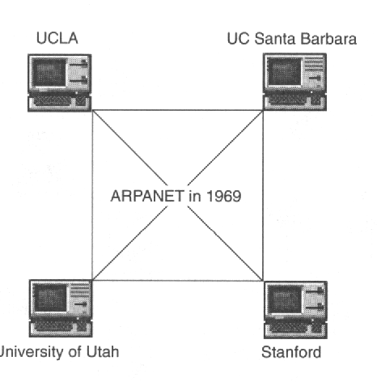
First four nodes on line at UCLA, Stanford, and other universities.

Slide 5
15 nodes, 23 host machines. Ray Thomlinson invents inter-system email (and later selects the “@” sign for e-mail addresses)
First international connections to the UK and Norway. Bob Kahn and Victor Cerf start work on “internetting” concepts. E-mail makes up 75% of ARPANET traffic.
Victor Cerf and Bob Kahn publish design of a Transmission Control Protocol (TCP) for packet internetworking. The TCP/IP protocal family is destined to become the common technical language of most computer networks and the Internet itself.
BITNET (Because Its Time Network) provided widespread email access. Minitel is deployed across France by French Telecom
First use of the term the “Internet”
TCP/IP becomes standared ARPANET protocol
Domain Name Server (DNS) introduced and number of host reached 1,000

Slide 6
NSFNET created a high speed backbone (56Kbps) to interconnect supercomputer centers
Number of hosts breaks 10,000
Number of hosts breaks 100,000 and NSFNET is upgraded to T1 line (1.544 Mbps)
ARPANET ceases to exist; The American National Science Foundation (NSF) takes over responsibility and funding for NSFNET, the physical network which has been at the heart of ARPANET and continues to serve the Internet.
WAIS released by Thinking Machines Corporation to aid information search
Gopher released by U of Minnesota

Slide 7
WWW released by CERN (a physics research institute in Switzerland)
Number of hosts breaks 1,000,000
NSFNET upgraded to T3 line (44.736 Mbps)
WWW annual growth rate 341,634%
Whitehouse goes online president@whitehouse.gov
United Nations & World Bank go on-line.
US National Infrastructure Act championed by Al Gore.
Mosaic developed by National Supercomputer Center

Slide 8
Netscape
Communities become wired to the Internet For example, Blacksburg, VA - bus & movie schedules on-line, town meetings, etc.
US Senate and House go on-line
Mass marketing frenzy on the Internet
USA sales at cybermalls grows to $200 million versus $50 billion in catalog sales & $1.5 trillion in total USA retail sales.
*.com sites exceed *.edu sites
Electronic commerce gets going seriously
The government uses the Internet for public dissemination of information (or political assassination ) by publishing Starr’s report on the Internet.

Slide 9
Now a large, growing, connection of over 10,000 networks and 30+ million users in over 60 countries.
NUA Survey: As of February 2002, 544.2 million on-line.

Slide 10

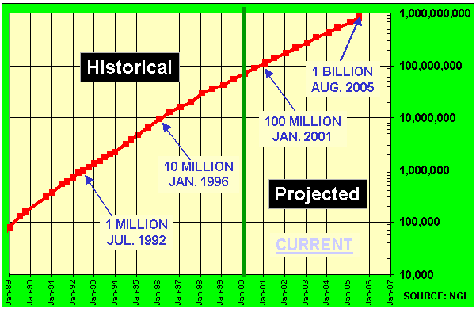
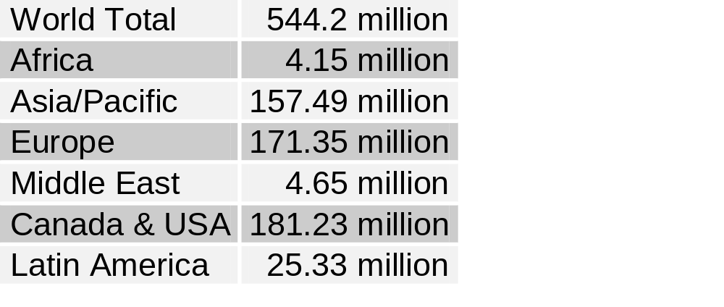
How Many Online?
Internet Host Count
As of February 2002

Slide 11
The Internet
The ‘net’ is composed of:
  Various types of wires and cable
  Computer hardware/ software
  Digital switches, and
  Peripheral technologies that support data flow and network security

Slide 12
IP Addresses
Each host on the Internet has a unique IP address
  Assigned by the Internet Corporation for Assigned Names and Numbers (ICANN http://www.icann.org/)
  32-bit address: dotted decimal notation, e.g., 204.202.129.230
  Each IP number represents one of 256 locations (domain.subdomain.organization.host)
  Each number represents an increasingly lower level of network (from Class A --> B --> C --> Node)

Slide 13
IP addresses are stored in domain name servers (DNS)
  Once a host knows the IP address of the intended receiver, the packets can be sent
  Each packet has an IP # for the sender, one for the receiver, and a sequence number for reassembling
We use alphabetic address:
(userID@host.institution.domain)
Main domains: edu, com, gov, mil, org, net + country codes
Local DNS converts this address into the IP address automatically
  Like phone book, matches the name to the phone number
  If it cannot resolve the address, it sends a request to the next DNS in the hierarchy
  This continues until the address is resolved or an error message is returned

Slide 14
Internet Host
What is an “Internet Host?”
  A computer on the Internet that has a permanent IP address.
  A service provider has one IP address for every 8~10 customers. Each IP address is associated with a phone line. When you dial up and make a connection, your computer is associated with the IP address allocated to the phone line you are connected.
  There are about 100,000,000 IP address on the Internet.

Slide 15
TCP/IP
TCP/IP ensures that messages are properly routed from sender to receiver and that these messages arrive intact.

Slide 16
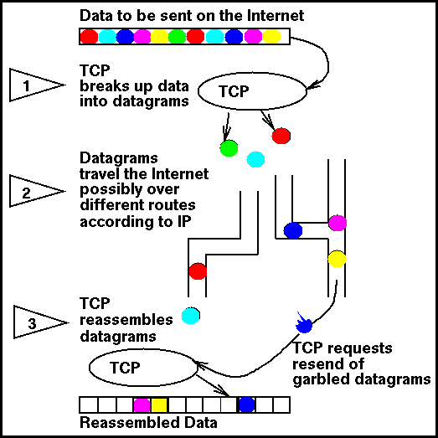
Packet Switching
TCP = TRANSMISSION
CONTROL
PROTOCOL
(Breaks messages into packets
and reassembles them)
IP = INTERNET PROTOCOL
(Moves packets around
the Internet)

Slide 17
Packet Switching
Packet switching is “first come-first served”
  It allows efficient sharing of expensive lines as senders take turns transmitting packets
  Since TCP/IP is “connectionless”, each packet is routed independently
  Each packet can take a different route!
  When congested, routers drop packets

Slide 18
Packet Switching
TCP/IP supports packet switching
  This ensures reliable communication despite the chaotic traffic flow on the net
  The data flow is broken up into ~200 byte packets which share the pipe, even though they originate in different sources
  Routers send them along the pipes that have the lowest traffic flow at a given point in time
  Routing algorithms are used to calculate traffic flow

Slide 19
The Internet
On October 24, 1995, the FNC unanimously passed a resolution defining the term Internet. This definition was developed in consultation with the leadership of the Internet and Intellectual Property Rights (IPR) Communities.
RESOLUTION: "The Federal Networking Council (FNC) agrees that the following language reflects our definition of the term "Internet". "Internet" refers to the global information system that –
  is logically linked together by a globally unique address space based on the Internet Protocol (IP) or its subsequent extensions/follow-ons;
  is able to support communications using the Transmission Control Protocol/Internet Protocol (TCP/IP) suite or its subsequent extensions/follow-ups and/or other IP-compatible protocols; and
  provides, uses or makes accessible, either publicly or privately, high level services layered on the communications and related infrastructure described herein."
A shared infrastructure, owned by no one: Much like the railway network, no one company owns it.

Slide 20
The Internet
The ‘net’ is composed of:
  Various types of wires and cable
  Computer hardware/ software
  Digital switches, and
  Peripheral technologies that support data flow and network security
Network connecting other networks

Slide 21
The Internet
Networks owned by different governments and organizations
Consists of different levels of backbone national level, regional level
The backbones are owned and operated by different Internet service providers and governments
The backbone meet at network access points (NAPs) and metropolitan area exchanges (MAEs).

Slide 22
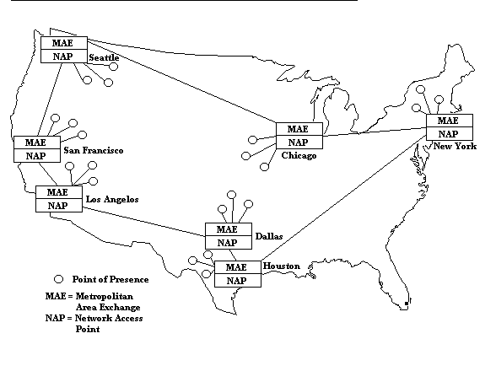
The Internet

Slide 23
The Internet
Backbones: carry data among regionals and owned by AT&T, Sprint, MCI, Qwest...
Regionals: connecting LANs to backbones
LANs
  Local, organizational, universities
  ISPs with local access through a national ISP
End users
  Dialup (50 Kbps)
  ISDN (64-128 Kbps)
  ASDL (1.5 Mbps/512 kbs
  LAN (1-10 Mbps)
  Cable modem (5-10 Mbps)
  Satellite dish...

Slide 24
Backbones
Backbones, owned by large ISPs and telecom companies, are made up of:
  MCI, Sprint, Qwest, IBM, ATT, ANS, etc.
    High-speed TCP/IP routers in a number of cities connected by...
    High-speed data lines leased from long-distance exchange carriers...
    Forming national “backbones” connecting those cities

Slide 25
Backbones
Backbone providers sell access to individuals and companies within each backbone city
  Traffic between cities moves over the leased-lines of the backbone
  Leased lines are purchased from different long-distance companies for each city
    Some providers lease several lines from different carriers to connect two cities
    If one carrier has a problem and the link is lost, a connection through the other carrier is used to maintaining the backbone.

Slide 26
Backbones
Currently, backbones are generally 45 Mbps DS-3 or faster leased lines
  A backbone operator may link a half dozen or a dozen major metropolitan areas using DS-3 lines
  They also extend dozens or even hundreds of less expensive 1.544 Mbps T-1 or DS-1 lines to surrounding communities from the major backbone cities
  They extend from those points with yet less expensive 56 Kbps leased lines

Slide 27
Major Players
Cisco Systems http://www.cisco.com/
Lucent Technologies <http://www.lucent.com>
Qwest Communications http://www.qwest.com/
Northern Telecom http://www.nortel.com
3Com <http://www.3com.com/>

Slide 28
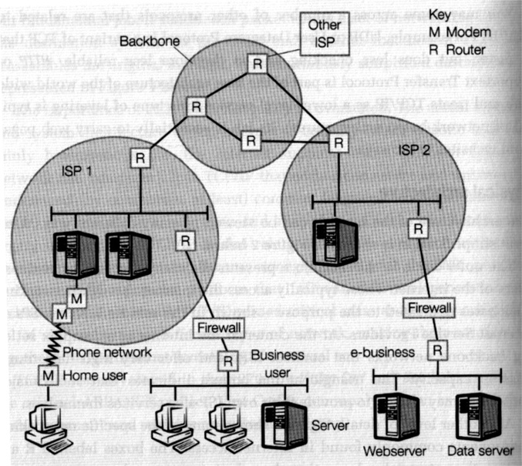
A Simplified View of the Internet

Slide 29
A Simplified View of the Internet
Home user
Connected to an ISP (labeled M) via a modem and the phone network.
The modem will allow a phone line to carry a digital signal.
The ISP has multiple modems to deal with many incoming phone calls).
Business user
A local area network of multiple machines.
A router (labeled R) takes a set of IP packets and sends them to the next stage of their journey across multiple points of interconnection between different networks.
A firewall (software & hardware) protects the business network from intrusion.

Slide 30
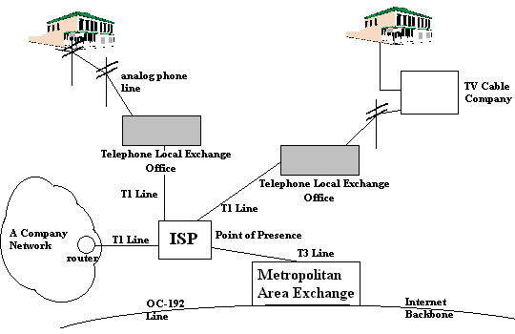
Connecting to an ISP

Slide 31
A Simplified View of the Internet
Internet Service Provider (ISP)
Provides access to both business and home users.
The ISP runs its own network, and may offer services such as website hosting (running customers’ websites) or its own contents (on-line service provider).
Backbone Networks
To route IP traffic to other points in the Internet, the ISP offers a “point of presens (POP)” that allows the ISP to connect to the backbone networks at the core of the Internet.
NSFNet in the early days of the Internet; Major operators today include MCI Worldcom, Sprint, Uunet, GTE, etc.

Slide 32
A Simplified View of the Internet
“Network Access Points (NAP)”
Allow backbone and and ISP traffic to be connected (see next slide)
E-business
See diagram labelled (ISP2) supporting e-business that runs its own website and associated data servers.
Users may access this e-business through the multiple links shown in the diagram.

Slide 33
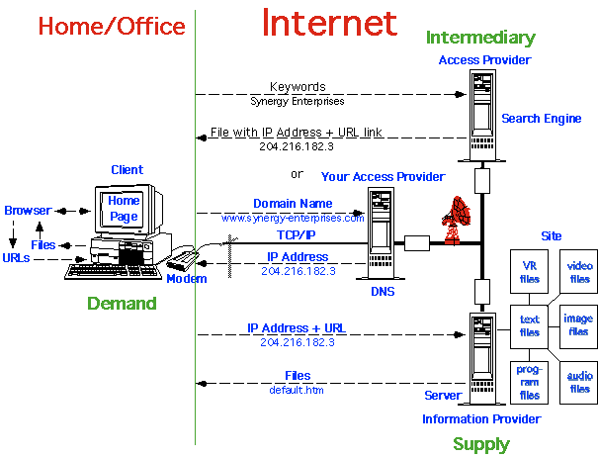
Internet Definitions Diagram

Slide 34
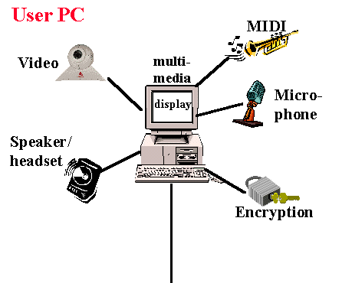
Internet: "The Big Picture "
User PC - A Multi-Media PC equipped to send and receive all variety of audio and video.

Slide 35
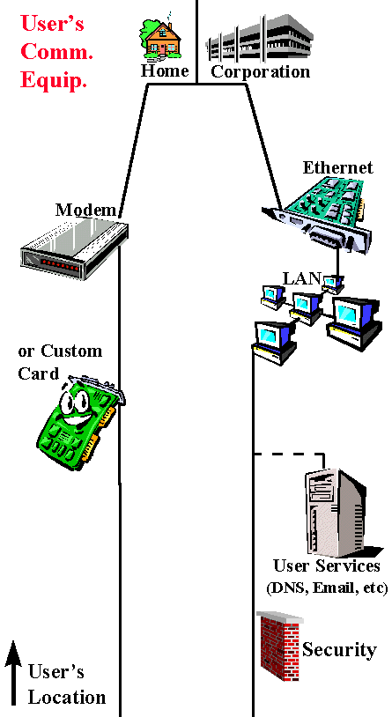
Internet: "The Big Picture "
User's Communication Equipment - This is the communication equipment located at the User's location(s) to connect the Users' PC(s) to the "Local Loop" (aka Customer Premise equipment - CPE)

Slide 36
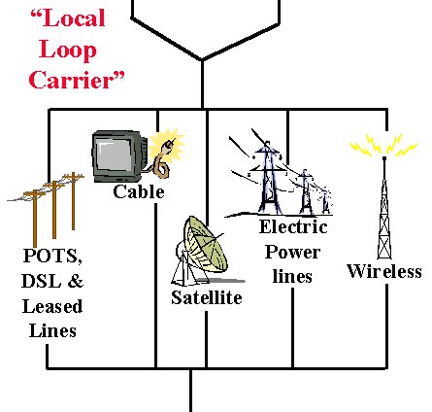
Internet: "The Big Picture "
Local Loop Carrier - Connects the User location to the ISP's Point of Presence

Slide 37
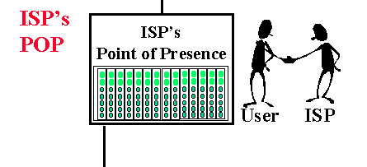
Internet: "The Big Picture "
ISP POP- This is the edge of the ISP's network. Connections from the user are accepted and authenticated here.

Slide 38
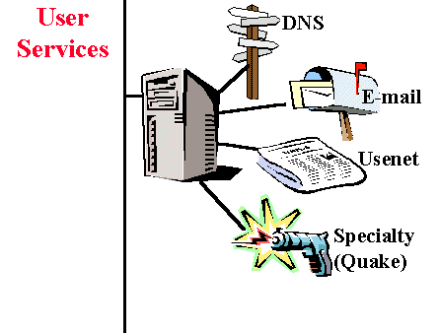
Internet: "The Big Picture "
User Services - these are the services that most users would use along with Internet Access.

Slide 39
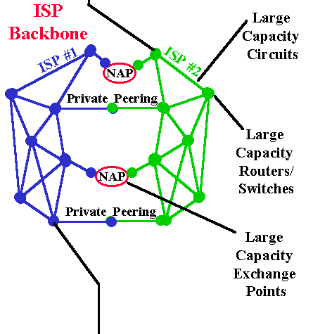
Internet: "The Big Picture "
ISP Backbone - The ISP backbone interconnects the ISP's POPs, AND interconnects the ISP to Other ISP's and online content.

Slide 40
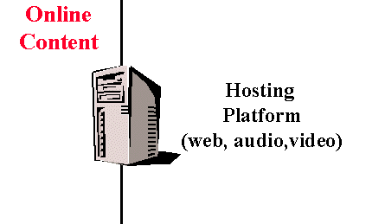
Internet: "The Big Picture "
Online Content - These are the host sites that the user interacts with.
Web Server platforms - Netsite, Apache, Microsoft, Yahoo's List of web servers.
Hosting Farms- Many online resources are hosted at well-connection facilities
These servers require fast interfaces and large/fast storage.

Slide 41
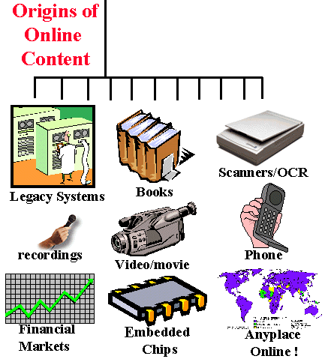
Internet: "The Big Picture "
Origins of online content - This is the original "real-world" sources for the online information.

Slide 42
Design Principles
Interoperability: systems can be assembled using client and server computers and software from different vendors.
Layering: Internet protocols are designed to work in layers, with each higher layer building on the facilities provided by the lower layers.

Slide 43
Simplicity
  Beside performing a specific function, each layer in a layered network hides network implementation details (the complexity of many different kinds of network hardware, topologies, and router) from the layers above it.
  IP provides only addressing and formatting of packets. Application developers and users are insulated from the complexities of different network hardware, topologies, and routers (e.g., Ethernet, dial-up connections, etc.), as well as the complexities of implementing low level network protocols.

Slide 44
IP Addresses
Uniform Naming and Addressing
  IP addresses track topology (physical location)
  Domain names track administrative responsibility.
  DNS is a distributed database of names.
  Network servers maintain tables of domain names.
  IP addresses are obtained by resolves that communicate with name servers on the net.

Slide 45
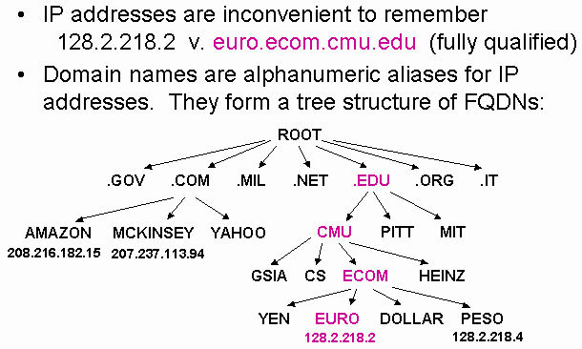
IP Addresses

Slide 46
IP Addresses
Each host on the Internet has a unique IP address
  Assigned by the Internet Corporation for Assigned Names and Numbers (ICANN http://www.icann.org/)
  32-bit address: dotted decimal notation, e.g., 204.202.129.230
  Each IP number represents one of 256 locations (domain.subdomain.organization.host)
  Each number represents an increasingly lower level of network (from Class A --> B --> C --> Node)

Slide 47
IP Addresses
IP addresses are stored in domain name servers (DNS)
  Once a host knows the IP address of the intended receiver, the packets can be sent
  Each packet has an IP # for the sender, one for the receiver, and a sequence number for reassembling
We use alphabetic address:
(userID@host.institution.domain)
Main domains: edu, com, gov, mil, org, net + country codes
Local DNS converts this address into the IP address automatically
  Like phone book, matches the name to the phone number
  If it cannot resolve the address, it sends a request to the next DNS in the hierarchy
  This continues until the address is resolved or an error message is returned

Slide 48
Internet Host
What is an “Internet Host?”
  A computer on the Internet that has a permanent IP address (fixed IP address).
  A service provider has one IP address for every 8~10 customers.
  Each IP address is associated with a phone line. When you dial up and make a connection, your computer is associated with the IP address allocated to the phone line you are connected.
  There are about 100,000,000 IP address on the Internet.

Slide 49
World Wide Web, Intranets and Extranets

Slide 50
World Wide Web

Slide 51
World Wide Web
In 1990, Tim Berners-Lee of CERN (the European Laboratory for Particle Physics) developed the World-Wide Web (www) and several communication protocols that form the backbone of the web.
The www allows computer users to locate and view multimedia-based documents (i.e., documents with text, graphics, animations, audios and/or videos) on almost any subject.

Slide 52
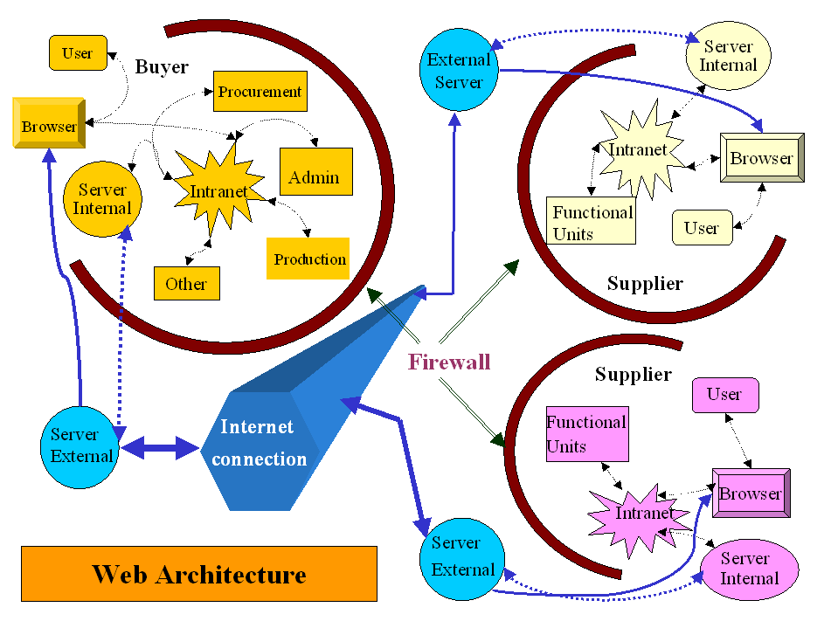

Slide 53
The World-Wide Web
Not the Internet
  WWW is one of many services on the internet.
  WWW can be considered to be a user-friendly interface to information on the internet.
Enabled by a standard: HTML... and VRML, Java, PDF, ...
Uses URL (Uniform Resource Locators): a unified address scheme that allows information to be exchanged using a variety of exchange techniques:
  Hypertext: http://www.whitehouse.gov/
  The white house
  FTP: ftp://ftp.iicm.edu/pub/Vrweb
  to access virtual library at Graz University of Technology in Austria
  Telnet: telnet://fedix.fie.com:23/
  to access the Federal Information Exchange

Slide 54
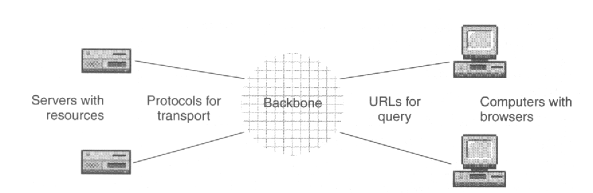
Uniform Resource Locator
URL identifies a specific resource on a server in a domain
URL tells what protocol to use to access the resource
URL format:
how://where/what
http://www.csupomona.edu/~hco

Slide 55
Other URL Protocols
https: secure, encrypted HTTP
ftp: file transfer protocol
mailto: email
telnet: remote login
news: obtain Usenet news
irc: Internet Relay Chat
finger: obtain information about a user
gopher: indexes of text files
archie: ftp databases

Slide 56
Browser
Implements HTTP (Hypertext Transfer Protocol)
  Displays web pages
  Access authentication
  Caching, freshness control
Font mapping, e.g. Unicode
http://www.unicode.org/iuc/iuc10/x-utf8.html
Compression, decompression
Handles multimedia, manages plug-ins
Interprets scripts
Executes Java applets
Maintains cache, history
Manipulates cookies

Slide 57
Effects of the Internet
The effects of the Internet are entirely produced by the electronic transmission of information ... and how that information may be used.
  Marketing and public relations
  Cost containment
  Entertainment
... and how that information may be found.
  Information Retrieval
  Distributed information
Notes:
“Electronic Commerce is the sharing of business information, maintaining business relationships, and conducting business transactions by means of telecommunications networks. ... E-commerce includes the sell-buy relationships and transactions between companies, as well as the corporate processes that support the commerce within individual firms.

Slide 58
Effects of the Internet
... and how that information may be shared or exchanged.
  Electronic Commerce
  Collaboration – outsourcing
  Coordination – Electronic Data Interchange(EDI)
  Groupware
... and how that information may affect our lives
  Political/social/economic issues – e.g., privacy
  Corporate structure
  Government/industry policy
  The global village and virtual communities
“Anything, anytime, anywhere...”

Slide 59
Intranet and Extranet

Slide 60
TCP/IP Network
Intranet
  A private TCP/IP network, often found in corporations. Typically protected from the Internet by a firewall.
Extranet:
  A network connecting an organization with its trading partners, suppliers, and customers.
  Extranet provides an exterior boundary that protects the organizations from the open network, while providing low security boundaries for greater sharing of information among the partners.

Slide 61
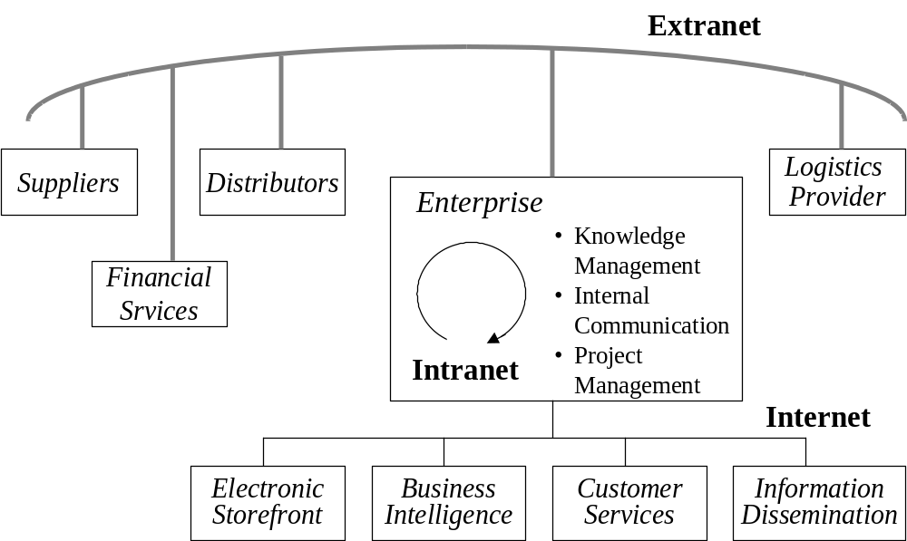

Slide 62
Intranet applications
Technology-driven marketing
Logistics and supply chain management
Finance and accounting
Human resources
Decision support/workflow management
Notes:
3
Technology-driven marketing: database and direct marketing, customer prospecting, and new modes of customer interaction
Logistics and supply chain management: Production planning and control, materials management and product distribution.
Finance and accounting: external (financial reporting), cash and treasury management, and internal accounting (such as bookkeeping, cost accounting, controlling, and transaction auditing).
Human resources: personal-date management, payroll accounting, benefits management and planning.
Decision support/workflow management: moving, storing, and retrieving documents across business units for better decision making.

Slide 63
Benefits and Drawbacks
Benefits
  Publishing ease
  Cost
  Ease of use
  Low maintenance
  Scalability
  Easy software distribution
Drawbacks
  Collaborative applications for Intranets are not as powerful as those offered by traditional groupware.
  Short-term risk.
  Less back-end integration.
Notes:
4
Publishing ease: An Intranet is an excellent platform for publishing information internally. It is easily deployable, as the ubiquitous Web browser is available for virtually every operating system.
Cost: Most organizations have already established TCP/IP networks, and the incremental infrastructure cost of adding Web servers to the network is well within even departmental-level budgets.
Ease of use: Corporate users already have Web browsers and can instantly access the information on internal Web sites.
Low maintenance: With information residing in only one place - the Web server - it is relatively easy and affordable to add new information or to update existing information and make it instantly available.
Scalability: Corporations will be able to deliver information systems on the least expensive computing platforms available and to scale their computing resources upward or downward as conditions shift.
Easy software distribution: Once PC users are equipped with Web browsers, new Web sites or pages with new information (or new applications) can be added without incurring the expense of locating users, sending them updated client software, and supporting them through the upgrade process.

Slide 64
Why Extranet?
Leverage existing investment in technology since most companies already have their documents online and Internet access.
Extranet applications developed to Internet standards are virtually guaranteed to work with Web browsers
Extranet applications can be customized to individual partners. Furthermore, the applications are accessible on a 24-hour basis, improving customer satisfaction.
Issues:
  Security and access privileges
  Web site management and maintenance

Slide 65
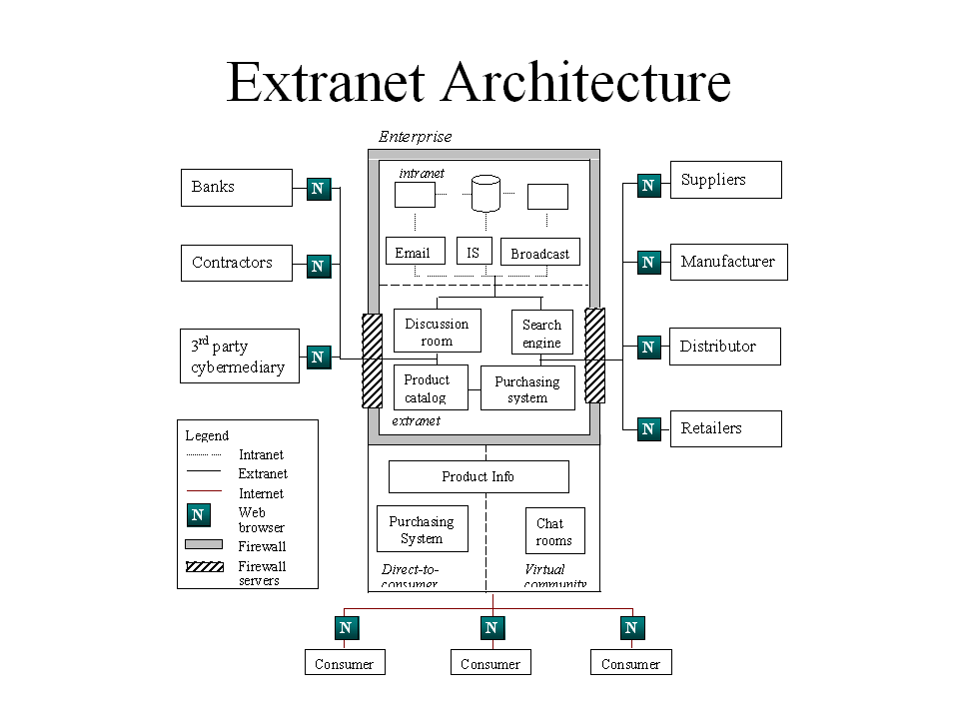
Source: (Shaw)

Slide 66
Extranet Components
Extranet servers—house the tools required for a Web presence, including:
  Security and access control
  Transaction management
  Site operations
  Extensible and scalable architecture
  Site operations and hosting
  Multiple platform compatibility
Extranet applications—business applications that allow people to communicate, exchange files, purchase goods or services, conduct info searches, monitor business details, etc.
Interface layers—bridges between system software and graphical user presentation .

Slide 67
Extranet-enabled Strategies
Information sharing
  improving coordination between business activities.
Content providers
  allowing strategic partner-suppliers to provide up-to-date content.
Revenue generator
  offering new online products and services.
Improved customer service
  providing customers with useful production information and tips.
  personalizing customer service through consumer profiles
New sales and distribution medium
  providing customizable, direct-consumer-sales.
  immediate delivery of digitizable products.

Slide 68
Extranet
Goal: Allowing business partners to access an enterprise’s information system and databases via the Internet network. Although current
Issues:
  Security and privacy—Setting up proper protocols to prevent illegal access and ensuring the privacy of sensitive data transmission.
  Management—Need someone to manage and maintain the extranet⇒3rd party brokers
Benefits:
  A low-cost solution for enabling enterprises to be linked together without the heavy investment to build explicit networks.
  Allows enterprises to build expandable and dynamic IS networks that match current business partners.
  Allows cross-industry SCNs.
Drawback: The technology is still primitive, does not fully support supply chain process integration.
Current applications: Mainly used for procurement transactions.

Slide 69
Virtual Private Network
VPN connects a company’s LAN to those of its suppliers and to its mobile employees
The network runs over the Internet and is therefore cost-effective
Encryption is used for security
VPN software at the server and the client end provide controlled access to resources

Slide 70
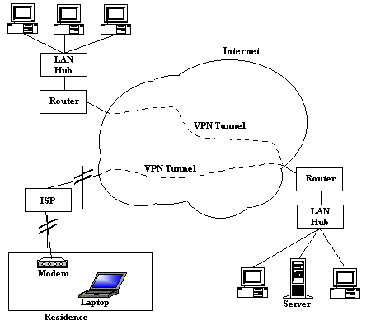
Virtual Private Network

